Slide 1
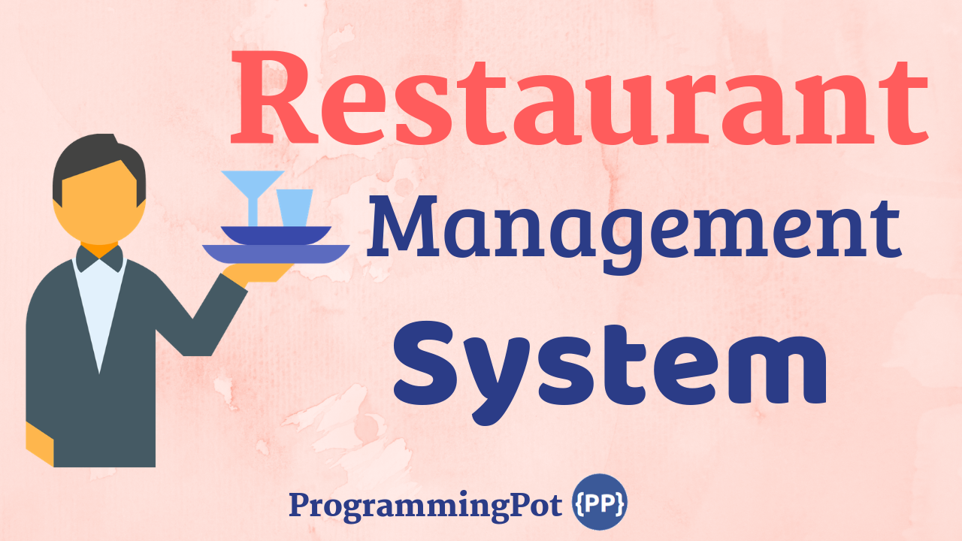

Slide 2
HumanManagement
Address
street: string city: string
Restaurant
- name: string address: Address - manager: Manager
1
StockManagement
CategoryManagement

Slide 3
HumanManagement
*
Abstract Person
# id: number # name: string # age: number # phone: number
Customer
*
Waiter
*
Staff
- salary: number
1
Manager
gender
1
<enum> Gender
MALE FEMALE OTHER
Chef
category
1
*
<enum> StaffCategory
WAITER MANAGER CHEF RECEPTIONIST
Receptionist
*

Slide 4
<enum> DrinksCategory
COCA-COLA, PEPSI, BACCHUS, OISHI STING, CAFÉ
StockManagement
*
MenuCategory
foods Beverages dessert
*
Drinks
#price:number
Beverage
drinks wine
*
Foods
# price: number
*
Dessert
# price: number
<enum> FoodCategory
LOK LAK, AMOK, PORK AND RICE CHECKEN RED CURRY PRAHOK KTIS NOM BANH CHOK SOMLOR KORKO
Wine
#price:number
Abstract Item
# name: string # quantity: number
<enum> WineCategory
GRAPE WINE, ROYAL WINE,

Slide 5
OrderManagement
TableType
CIRCLE, RECTANGLE, SQUARE
Kitchen
chefId: number orderId: number
Table
1
*
Table
+ tableId: number
*
1
Order
+ orderId: number + tableId: number + menuItemId: number
*
Chair
+ chairId: number + tableId: number + customer: Customers
*
1
Payment
paymentId: number billId: number
Bill
billId: number totalBill: number orderId: number
<enum> PaymentSection
CASH CARD
1
1
1
Cash
Card

